Slide 1
Natural language processing
Week 14
Ph.D. Junetae, Kim
Assistant professor

Slide 2
Contents
Word Tokenizing
Word embedding
Classification model based on natural language.

Slide 3
Introduction to natural language processing
What is natural language processing?
Definition:
A subfield of artificial intelligence (AI) that focuses on enabling computers to understand, interpret, and generate human language.
Key Components:
Syntax: Understanding the grammatical structure of sentences
Semantics: Extracting meaning from words and sentences

Slide 4
Introduction to natural language processing
Applications of NLP
Machine translation
Google Translate helps users instantly translate text between multiple languages.
Sentiment analysis
Businesses analyze customer reviews to identify positive or negative sentiment towards their products or services.
Speech recognition
Siri and Google Assistant transcribe spoken words into text for voice commands or dictation.
Chatbots and virtual assistants
Customer support chatbots on websites help answer user queries without human intervention.
Information extraction and retrieval
Search engines like Google use NLP to understand queries and provide relevant search results.

Slide 5
Introduction to natural language processing
NLP Techniques and Models
Traditional Approaches:
Rule-based systems
Statistical methods
Machine learning (e.g., Naïve Bayes, Support Vector Machines)
Recent approaches: Deep Learning:
Introduction to deep learning for NLP
Recurrent Neural Networks (RNNs) and Long Short-Term Memory (LSTM) networks
Attention mechanisms and Transformer models
State-of-the-art models: BERT, GPT, and OpenAI's GPT-4
Challenges and Future Directions:

Slide 6
Introduction to natural language processing
What is Tokenization?
Definition:
The process of breaking a sentence or text into smaller units, called tokens
Tokens are usually words, but can also be phrases or sentences
Importance of tokenization
It's the first step in text preprocessing for various NLP tasks
It helps in analyzing and understanding the structure of a text
It facilitates the extraction of meaningful information from text data

Slide 7
Introduction to natural language processing
What is Tokenization?
Example:
Original Sentence: "We enjoy ice cream on hot summer days."
Tokenized Sentence: ["We", "enjoy", "ice", "cream", "on", "hot", "summer", "days."]
Tools:
from tensorflow.keras.preprocessing.text import text_to_word_sequence, Tokenizer
text_to_word_sequence and Tokenizer are both tokenization methods, and have different use cases and features.

Slide 8
Introduction to natural language processing
What is Tokenization?
text_to_word_sequence:
A simple function that takes a text string as input and returns a list of words.
It uses space as a delimiter and removes punctuation marks.
It's suitable for basic tokenization when working with single sentences or a small dataset.

Slide 9
Introduction to natural language processing
What is Tokenization?
Tokenizer:
A more advanced and customizable class for tokenization.
It can handle large datasets and multiple texts.
Provides additional functionality, such as counting word frequency, converting words to indices, and creating a dictionary-like mapping of words.
It allows for more control over the tokenization process, such as defining custom filters, setting the maximum number of words, and choosing a specific tokenizer.

Slide 10
Introduction to natural language processing
Tokenization and Sequence Length
Sequence Length
Tokenized sequences can have varying lengths
Deep learning models require fixed-length input
3-word sentence:
The cat jumped
4-word sentence:
She opened the door
5-word sentence:
Children played in the park

Slide 11
Introduction to natural language processing
Tokenization and Sequence Length
Sequence Length
Tokenized sequences can have varying lengths
Deep learning models require fixed-length input
3-word sentence:
The cat jumped nan.
4-word sentence:
She opened the door
5-word sentence:
Children played in the park
Fixed input length

Slide 12
Introduction to natural language processing
Tokenization and Sequence Length
maxlen: Maximum Length
Parameter to define the maximum length for each sequence
Shorter sequences are padded; longer sequences are truncated
Word | Integer
the | 1
cat | 2
jumped | 3
she | 4
opened | 5
door | 6
children | 7
played | 8
in | 9
park | 10
The cat jumped → [1 , 2 , 3]
She opened the door → [4 , 5 , 1 , 6]
Children played in the park → [7 , 8 , 9 , 1 , 10]

Slide 13
Introduction to natural language processing
Tokenization and Sequence Length
maxlen: Maximum Length
Parameter to define the maximum length for each sequence
Shorter sequences are padded; longer sequences are truncated
If maxlen ==3:
The cat jumped → [1 , 2 , 3]
She opened the door → [4 , 5 , 1 , 6] or [4 , 5 , 1 , 6]
Children played in the park → [7 , 8 , 9 , 1 , 10] or [7 , 8 , 9 , 1 , 10] or …
truncating

Slide 14
Introduction to natural language processing
Tokenization and Sequence Length
maxlen: Maximum Length
Parameter to define the maximum length for each sequence
Shorter sequences are padded; longer sequences are truncated
If maxlen ==4:
The cat jumped → [1 , 2 , 3 , 0]
She opened the door → [4 , 5 , 1 , 6] or [4 , 5 , 1 , 6]
Children played in the park → [7 , 8 , 9 , 1 , 10] or [7 , 8 , 9 , 1 , 10] or …
Padding

Slide 15
Introduction to natural language processing
Understanding text_to_word_sequence vs Tokenization
https://colab.research.google.com/github/JunetaeKim/DeepLearningClass/blob/main/Week14/Tokenization.ipynb

Slide 16
Introduction to natural language processing
Introduction to One-Hot Encoding with Keras
What is One-Hot Encoding?:
A method to convert categorical data, such as words, into numerical representations.
Represents each word as a binary vector with a length equal to the size of the vocabulary
Why use One-Hot Encoding?:
Machines can't directly understand text data, so we convert words into numerical representations
One-Hot Encoding is an easy and straightforward method for this conversion
Provides a simple input format for various NLP tasks and machine learning algorithms

Slide 17
Introduction to natural language processing
Introduction to One-Hot Encoding with Keras
A step-by-step guide with Keras
Step 1: Tokenize the text
Use Keras' Tokenizer class to tokenize the text and build the vocabulary
Step 2: Convert words to indices
Use the texts_to_sequences method to map words to their corresponding indices
Step 3: Perform One-Hot Encoding
Use Keras' to_categorical function to convert word indices into one-hot vectors

Slide 18
Introduction to natural language processing
Introduction to One-Hot Encoding with Keras
Example text:
“We enjoy ice cream on hot summer days.”
Result of one-hot encoding
We
enjoy
ice
cream
on
hot
summer
days
[0. 1. 0. 0. 0. 0. 0. 0. 0.]
[0. 0. 1. 0. 0. 0. 0. 0. 0.]
[0. 0. 0. 1. 0. 0. 0. 0. 0.]
[0. 0. 0. 0. 1. 0. 0. 0. 0.]
[0. 0. 0. 0. 0. 1. 0. 0. 0.]
[0. 0. 0. 0. 0. 0. 1. 0. 0.]
[0. 0. 0. 0. 0. 0. 0. 1. 0.]
[0. 0. 0. 0. 0. 0. 0. 0. 1.]

Slide 19
Introduction to natural language processing
One-Hot Encoding with Keras
https://colab.research.google.com/github/JunetaeKim/DeepLearningClass/blob/main/Week14/OneHotKeras.ipynb

Slide 20
Introduction to natural language processing
Limitations and Alternatives to One-Hot Encoding
Limitations of One-Hot Encoding
Sparse representation: For large vocabularies, one-hot vectors can become very large with mostly zero values
Lack of semantic information: One-Hot Encoding doesn't capture relationships or similarities between words
Alternative Techniques
Word Embeddings (e.g., Word2Vec, GloVe): Dense, fixed-size vector representations that capture semantic relationships between words
Pre-trained Language Models (e.g., BERT, GPT): Provide contextualized word representations and improve performance on various NLP tasks

Slide 21
Introduction to natural language processing
Introduction to Word Embeddings
What are Word Embeddings?
Dense, fixed-size vector representations of words
Capture semantic relationships and similarities between words
Transform words into continuous vectors, enabling efficient processing and better performance in NLP tasks
Why use Word Embeddings?
Efficient and scalable, suitable for large datasets and vocabularies
Captures complex semantic and syntactic relationships
Pre-trained models available for various languages and domains
Facilitates learning from word similarities and relationships

Slide 22
Introduction to natural language processing
Word Embeddings vs One-Hot Encoding
Word size + 1
We
enjoy
ice
cream
in
summer
0 | 1 | 0 | 0 | 0 | 0 | 0
0 | 0 | 1 | 0 | 0 | 0 | 0
0 | 0 | 0 | 1 | 0 | 0 | 0
0 | 0 | 0 | 0 | 1 | 0 | 0
0 | 0 | 0 | 0 | 0 | 1 | 0
0 | 0 | 0 | 0 | 0 | 0 | 1
One-Hot Encoding
We
enjoy
ice
cream
in
summer
0.15 | -0.1 | 1.23
-2.12 | -1.41 | 0.54
-1.89 | 0.1 | 0.89
0.76 | -0.57 | 1.67
1.25 | 1.61 | 0.87
1.54 | 0.97 | -0.78
Word embedding
Efficient and effect approach
Hyper-parameter

Slide 23
Introduction to natural language processing
Introduction to Word Embeddings
Two learning algorithms for creating Word Embeddings
Continuous Bag-of-Words (CBOW): Predicts a target word based on its surrounding context words
Skip-gram: Predicts context words given a target word

Slide 24
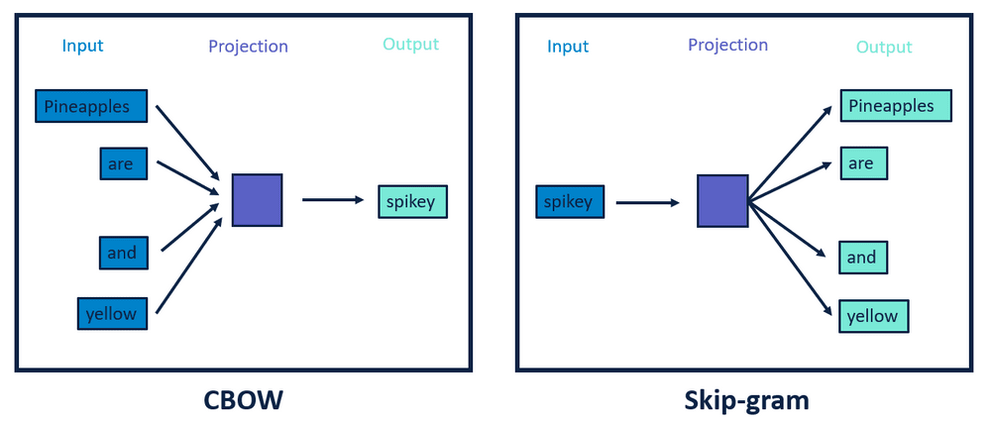
Introduction to natural language processing
Introduction to Word Embeddings
CBOW vs Skip-gram
Source: https://dataaspirant.com/wp-content/uploads/2020/08/10-cbow-word2vec.png

Slide 25
Introduction to natural language processing
Word Embedding with Keras
Mechanism and procedure for Word Embeddings in Keras
Step 1: Word → Integer mapping
We → 0 , enjoy → 1 , ice → 2 , cream → 3, etc
Step 2: Integer → lookup table → embedding vector
Using a lookup table, when a specific word is encountered, the corresponding integer ID is used to retrieve the associated embedding vector.
We → 0 →
enjoy → 1 →

Slide 26
Introduction to natural language processing
Word Embedding with Keras
Embedding() Function in Keras:
from keras.layers import Embedding
Two mandatory parameters
① the size of the ‘input’ and ② the size of the ‘output.’
Ex) “Embedding(16, 4)“means that there are a total of 16 unique words for input, and the output vector size after embedding will be 4.
Optional parameter
the input_length: to control how many words are fed into the model at once
"Embedding(16, 4, input_length=2)" indicates that although there are 16 unique input words, only 2 words will be processed in each iteration.

Slide 27
Introduction to natural language processing
Understanding the Mechanism of Word Embedding with Keras
https://colab.research.google.com/github/JunetaeKim/DeepLearningClass/blob/main/Week14/WordEmbedding.ipynb

Slide 28
Introduction to natural language processing
Simple Application Exercise
Sentiment Analysis Overview
Definition: Sentiment analysis, also known as opinion mining, is the process of determining the sentiment or emotion expressed in a piece of text.
Types of sentiment analysis: Binary (positive/negative), multi-class (positive/neutral/negative), and sentiment intensity.

Slide 29
Introduction to natural language processing
Simple Application Exercise
Building a Sentiment Analysis Model
Data preparation: 20 toy sentences (10 pos. and 10 neg.)
Padding: Making all input sequences have the same length by either padding shorter sequences with zeros at the end or truncating longer sequences to the specified maximum length.
Model architecture: Design the neural network architecture, including embedding and DNN layers.

Slide 30
Introduction to natural language processing
Building a Sentiment Analysis Model with Keras
https://colab.research.google.com/github/JunetaeKim/DeepLearningClass/blob/main/Week14/ToySentimental.ipynb

Slide 31
Introduction to natural language processing
Exercise1: Reuters News Category Classification
Reuters Data overview
A dataset of 11,228 newswires from the Reuters news agency
Labeled across 46 different topics
Dataset structure
Data can be divided into training and testing sets
Each sample is a list of integers, representing words as indices
Words are preprocessed and tokenized

Slide 32
Introduction to natural language processing
Exercise1: Reuters News Category Classification
Labels
Integer labels ranging from 0 to 45
Represent the 46 different topics/categories
Label information: https://martin-thoma.com/nlp-reuters/
Usage in Keras
Easily accessible using keras.datasets.reuters
Can limit the number of words by specifying the num_words parameter
Word index mapping can be obtained using reuters.get_word_index()

Slide 33
Introduction to natural language processing
Exercise1: Reuters News Category Classification
Goals:
Model Structure Objectives:
Create a layer that embeds sentences.
Design a structure where embedded vectors pass through an LSTM layer for predictions.
Model Evaluation:
Assess the performance of the model on the given dataset.
Student Challenge:
Making classification of a new sentence into one of the Reuters news categories.

Slide 34
Introduction to natural language processing
Exercise1
For students
https://colab.research.google.com/github/JunetaeKim/DeepLearningClass/blob/main/Week14/ReutersNews.ipynb
For solutions
https://colab.research.google.com/github/JunetaeKim/DeepLearningClass/blob/main/Week14/ReutersNewsSolution.ipynb

Slide 35
Introduction to natural language processing
Word Embedding Visualization
Introduction to UMAP for Word Embedding Visualization
UMAP is a non-linear dimensionality reduction technique
It preserves both local and global structure of the high-dimensional data
Suitable for visualizing complex data structures, such as word embeddings.
Why use UMAP for word embeddings?
Word embeddings can have high dimensionality (e.g., 100, or more dimensions)
Visualizing high-dimensional data is challenging
UMAP helps to project high-dimensional data onto a 2D or 3D space, which is easier to visualize and interpret

Slide 36
Introduction to natural language processing
Word Embedding Visualization
Steps of Word Embedding Visualization
Obtain word embeddings
Train a model with an embedding layer
Extract the embedding matrix (word vectors) from the trained model
Apply UMAP for dimensionality reduction
Create a UMAP reducer with desired parameters
Fit the reducer to the embedding matrix and transform it into a lower-dimensional space
Visualize the reduced embeddings
Use a visualization library to create a scatter plot of the 2D embeddings
Interpret the plot to identify clusters, relationships, and patterns between words

Slide 37
Introduction to natural language processing
Word Embedding Visualization
https://colab.research.google.com/github/JunetaeKim/DeepLearningClass/blob/main/Week14/VisualizationEmbedding.ipynb

Slide 38
Introduction to natural language processing
Exercise2: Prediction of Sentiment Labels on the IMDB Dataset
Objective
Build models to predict sentiment labels on the IMDB dataset
IMDB Dataset
A popular dataset for sentiment analysis containing movie reviews
50,000 movie reviews labeled as positive (1) or negative (0)
The dataset is preprocessed and available in Keras

Slide 39
Introduction to natural language processing
Exercise2: Prediction of Sentiment Labels on the IMDB Dataset
Model Architectures
Embedding: Convert words into dense vectors that capture the semantic meaning
CNN: Apply convolutional layers to detect local patterns in the sequence of word vectors
LSTM: Use LSTM layers to model long-range dependencies and capture the temporal structure of the text

Slide 40
Introduction to natural language processing
Exercise2: Prediction of Sentiment Labels on the IMDB Dataset
Preprocess data
Load the IMDB dataset using Keras
Limit the vocabulary to the top 10,000 most frequent words
Pad the sequences to a fixed length of 500 words for input to the models
Create models
Build a model using Embedding, CNN, and LSTM layers
Combine layers as needed, e.g., Embedding followed by CNN and LSTM
Train models
Compile the model using binary cross-entropy loss and the RMSprop optimizer
Fit the model using the training data
Monitor training progress and loss/accuracy metrics with validation data

Slide 41
Introduction to natural language processing
Exercise2: Prediction of Sentiment Labels on the IMDB Dataset
Evaluate performance
Test the model's performance on the test dataset
Report loss and accuracy metrics
Analyze embeddings
Extract the word embeddings from the trained model
Compute cosine similarity between pairs of word vectors to measure their semantic similarity
Use cosine similarity to analyze the relationships between words in the learned embedding space
Visualize the cosine similarity matrix using a heatmap
Apply clustering to the heatmap to reveal patterns in the word embeddings

Slide 42
Introduction to natural language processing
Cosine Similarity for Word Embeddings
What is cosine similarity?
A widely-used metric to measure the similarity between two vectors
It calculates the cosine of the angle between the two vectors
Ranges between -1 and 1, where -1 indicates complete dissimilarity, 1 indicates complete similarity, and 0 indicates orthogonality (independence)
Suitable for high-dimensional data, such as word embeddings

Slide 43
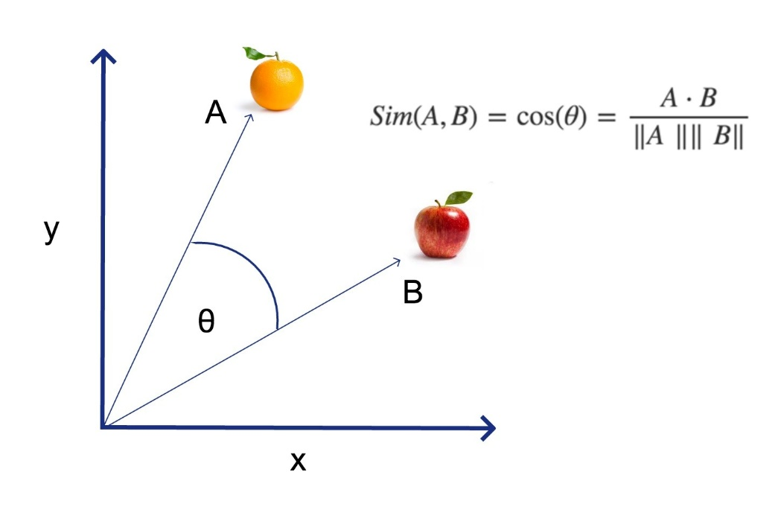
Introduction to natural language processing
Cosine Similarity for Word Embeddings
What is cosine similarity?
Cosine Similarity(A, B) = (A • B) / (||A|| ||B||)
where A and B are vectors, • denotes the dot product, and ||A|| and ||B|| represent the magnitudes of A and B, respectively
Source: https://aitechtrend.com/how-cosine-similarity-can-improve-your-machine-learning-models/

Slide 44
Introduction to natural language processing
Exercise2: Prediction of Sentiment Labels on the IMDB Dataset
Steps of Applying Cosine Similarity to Word Embeddings
Extract embedding matrix from the trained model
Compute the cosine similarity between pairs of word vectors using the formula
(Optional) Select a subset of word vectors for reduced computation
Analyze and visualize the cosine similarity matrix using heatmaps, clustering, or other visualization techniques

Slide 45
Introduction to natural language processing
Prediction of Sentiment Labels on the IMDB Dataset
https://colab.research.google.com/github/JunetaeKim/DeepLearningClass/blob/main/Week14/IMDBClassification.ipynb

